Slide 1




ML4DS
Machine Learning for Data Science
Final presentation

Slide 2
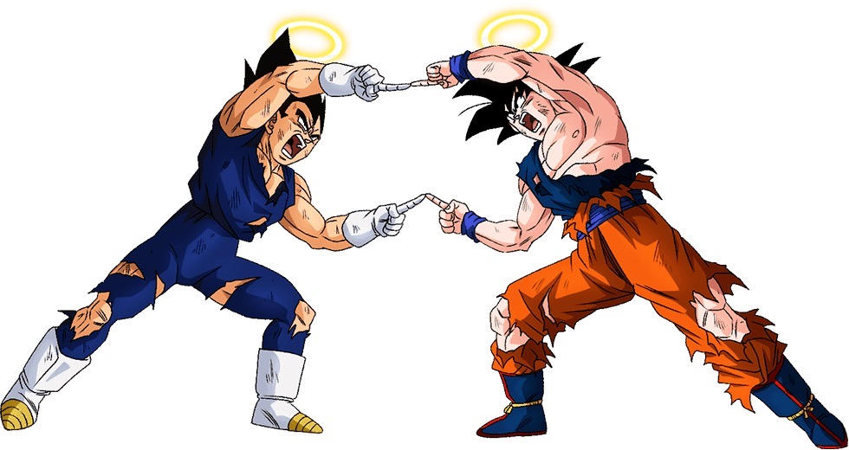
Leonardo Canuto
Vinicius Takemoto
Sergio Lugo Couros
Raúl Lorenzo Parrado

Slide 3

Summary
Introduction
Methodology
Our Approach
CNNs for Glaucoma Classification
Results
GradCam
Surrogate models
Conclusion

Slide 4
Methodology
We began the work by conducting research to determine the best model to work with.
For this, we use the famous divide and conquer strategy :)
Our group split into two to investigate and look for clues. Like…

Slide 5
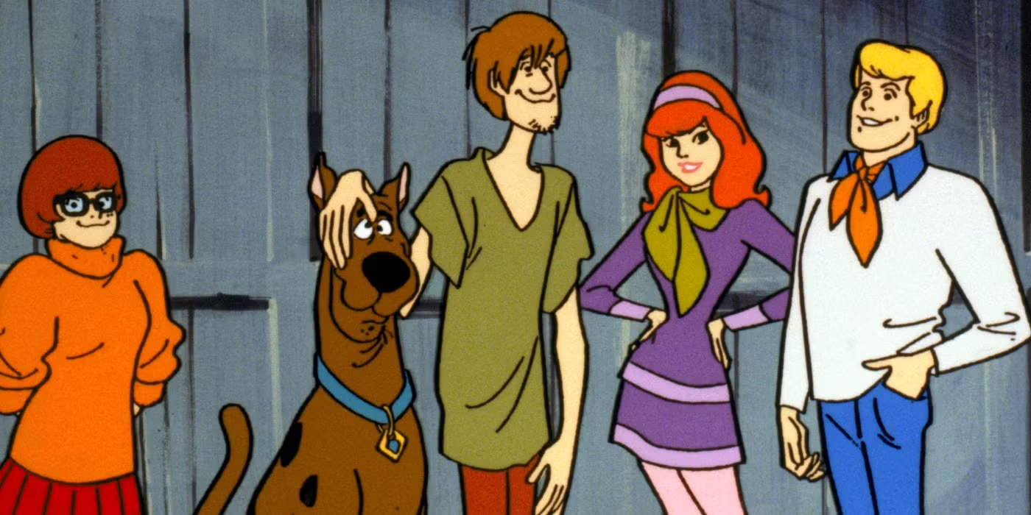
Methodology

Slide 6
Methodology
And each of the pairs found your best model:
VGG19
and
ResNet50

Slide 7
VGG 19 (Data transformation)
Training pipeline applies:
Resize all images to 224×224
Random horizontal flip with probability (0.5) to add mild left-right invariance
Random rotation up to 15° to add small viewpoint/pose robustness
Use a ColorJitter was removed to preserve original morphological/visual features (avoid altering color-based cues)
Convert images to PyTorch tensors
Normalize using ImageNet mean [0.485,0.456,0.406] and std [0.229,0.224,0.225] to match common pretrained model expectations and stabilize training
Test pipeline applies:
Resize to 224×224
Convert to tensor
Apply the same ImageNet normalization to ensure train/test preprocessing consistency

Slide 8
VGG 19 Approach
VGG19_bn
Batch size: 32
Learning rate: 0.001
Optimizer: Adam
Epochs: 20
Dropout: 0.7
Custom_head:
Layer_1: Linear(512 -> 256)
Activation: ReLU
Dropout_1: 0.7
Layer_2: Linear(256 -> 2)
Pretrained Weights → ImageNet1K_V1

Slide 9
Results
VGG19_bn
Performance metrics | Local set | Teacher’s set
Balanced Accuracy | 0.8676 | 0.7608
Accuracy | 0.8904 | 0.7362
Precision | 0.5616 | 0.4811
Recall (Sensitivity) | 0.9468 | 0.8095
Specificity | 0.7884 | 0.7120
F1 Score | 0.9175 | 0.6036
AUC-ROC | 0.9592 | 0.8669

Slide 10
Results
Performance metrics | Training Set | Test Set + Training Set
Balanced Accuracy | 0.7608 | 0.7715 ↑
Accuracy | 0.7362 | 0.7283 ↓
Precision | 0.4811 | 0.4737 ↓
Recall (Sensitivity) | 0.8095 | 0.8571 ↑
Specificity | 0.7120 | 0.6859 ↓
F1 Score | 0.6036 | 0.6102 ↑
AUC-ROC | 0.8669 | 0.8881 ↑
VGG19_bn (trained with all the data)

Slide 11
ResNet50 Approach
Training Setup
Architecture: ResNet50 Pretrained
Batch size: 32
Learning rate: 0.0001
Optimizer: AdamW
Epochs: 50 (with early stop)
Reduce Learning Rate on plateau

Slide 12
ResNet50 Approach
Data Preprocessing
K-Fold Cross-Validation
Best Model Selection
Final Inference
Resize, Augmentation, Normalization
Training, Loss, Threshold
Max Balanced Accuracy
Apply fixed validation Threshold

Slide 13
Results
Performance metrics | Local set | Teacher’s set
Balanced Accuracy | 0.8965 | 0.8684
Accuracy | 0.9110 | 0.8740
Precision | 0.9175 | 0.7013
Recall (Sensitivity) | 0.9468 | 0.8571
Specificity | 0.8462 | 0.8796
F1 Score | 0.9319 | 0.7714
AUC-ROC | 0.9730 | 0.9378
ResNet50

Slide 14
GradCam
We used GradCam to explain how our model was making the classification.
And for two different approaches we found two different results:

Slide 15
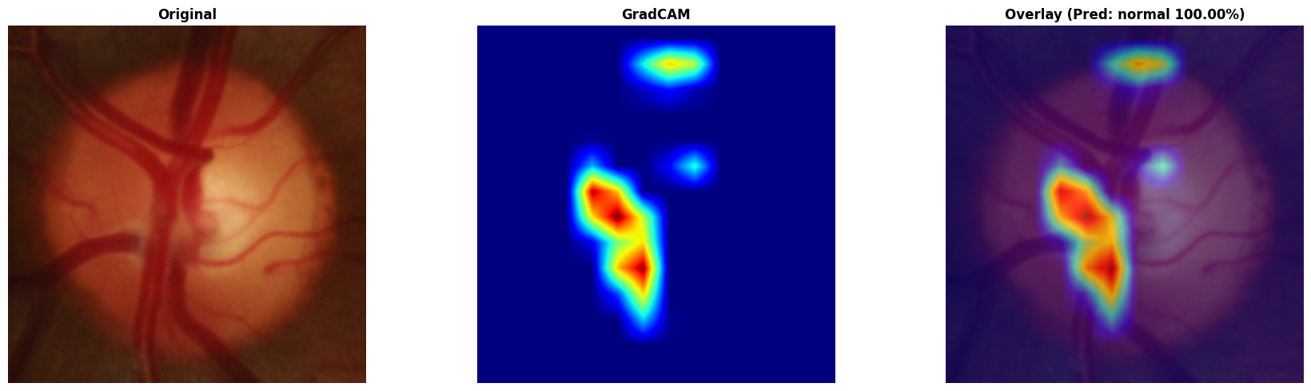
GradCam
VGG19_bn

Slide 16
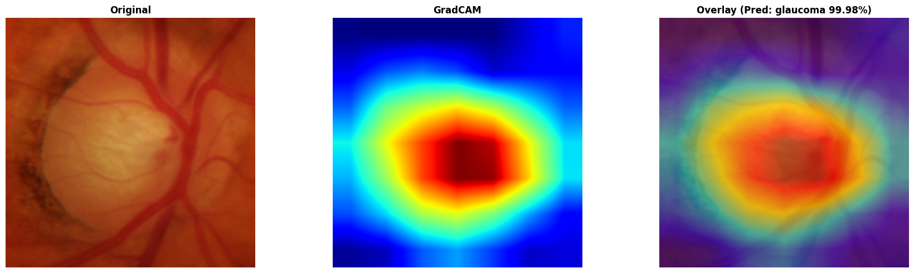
GradCam
ResNet50

Slide 17
Surrogate models
01
Linear Regression
MSE: 0.0644
MAE: 0.1946
R²: 0.6676
02
Regression Tree Depth 5
MSE: 0.1119
MAE: 0.177
R²: 0.4219
03
Regression Tree Depth 10
MSE: 0.1256
MAE: 0.1726
R²: 0.3511
04
Random Forest
MSE: 0.0608
MAE: 0.1435
R²: 0.6859

Slide 18
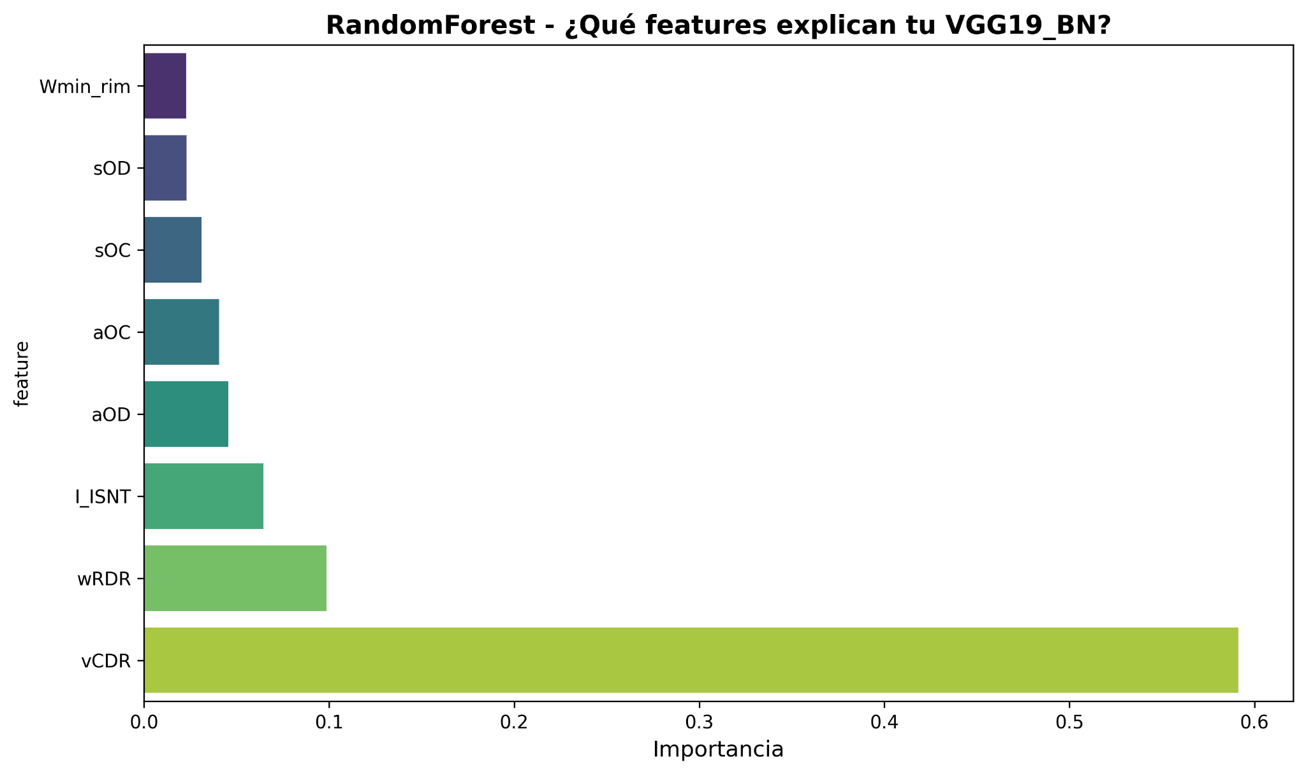
Surrogate models

Slide 19
Conclusion
The work achieved consistent results, the methodologies applied worked, and we had excellent outcomes. It was very important to use observability methods, such as GradCam and surrogate models.
The application of machine learning studies in the healthcare is extremely exciting and crucial for the future we are building.
Faster diagnoses allow people to treat illnesses and recover faster, purposeful technology can change lives.

Slide 20
Thank you!!!
Gracias!!!

